Slide 1


HAPPY
MOTHER’S
Dedicaded to the strongest and most beloved
DAY

Slide 2
DAY
HAPPY
MOTHER’S
Dedicated to the strongest and most beloved

Slide 3



Why is this day special?
Mother's Day is a holiday when we thank our mothers for their warmth, care and endless love.
This holiday was first celebrated in the USA in 1908.

Slide 4
The Story Behind "Mama"
Universal Word
Easy to Say
First Sounds
“Mama” sound similar across many languages
The "m" sound is easy
for babies to pronounce
“Mm” is one of the first
sounds a child makes
أمي
妈妈
Mum
Maman
Mamá
Mẹ
Μαμά

Slide 5


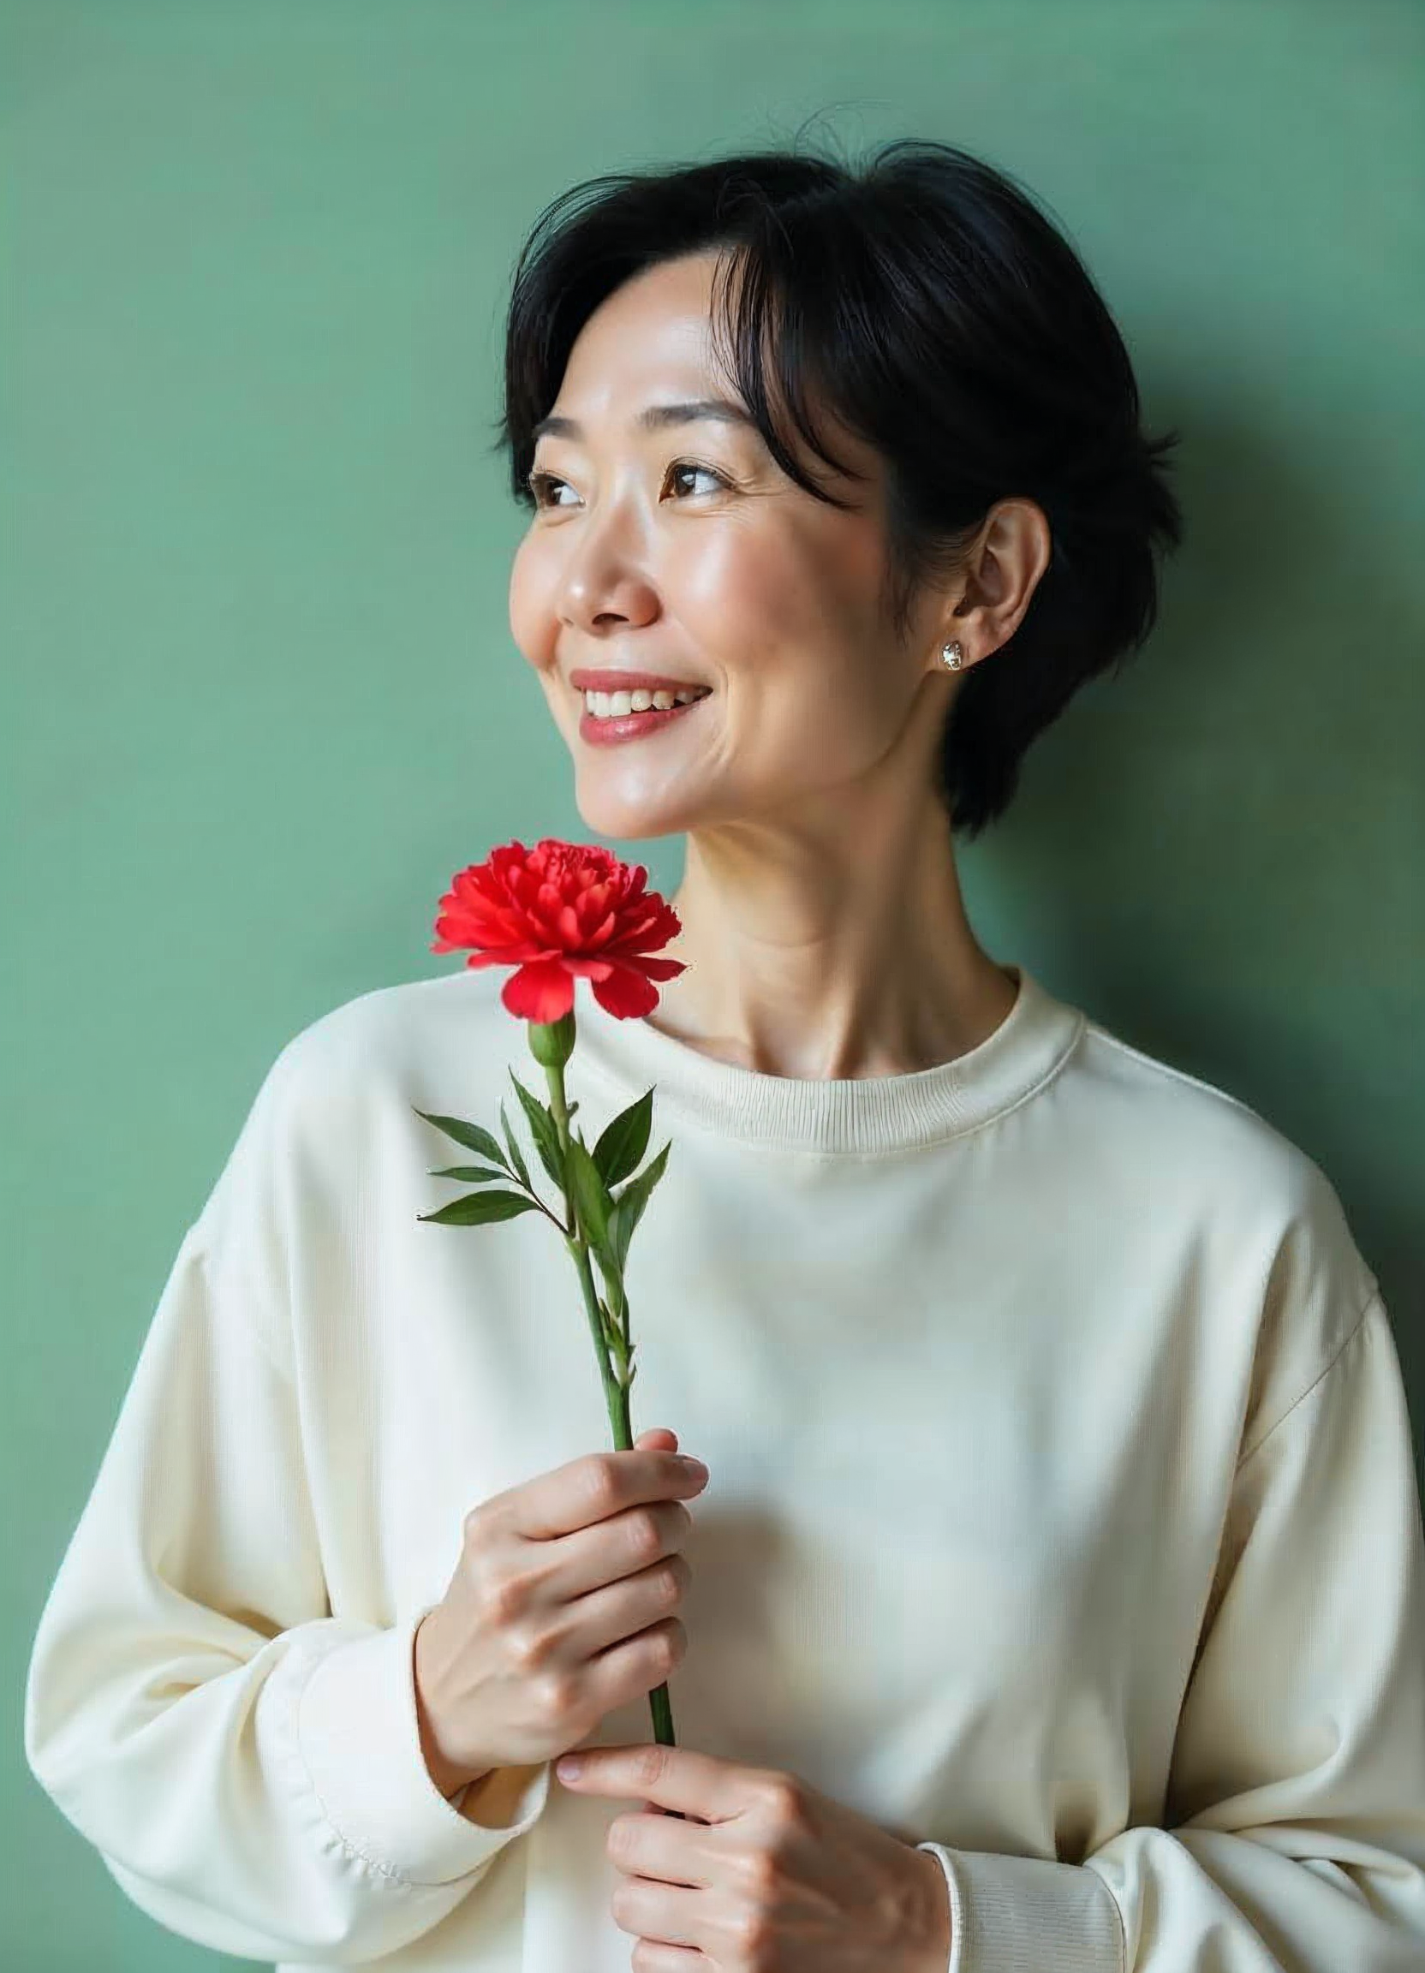
Mother’s day around the World
All over the world, mothers are revered in a special way

Slide 6
Mother’s day around the World
In the UK
it’s a tradition to serve breakfast in bed for mums on Mothering Sunday
Children and dads wake up early
to surprise mum with tea, toast,
and sweet treats in bed

Slide 7
Mother’s day around the World
In the USA
The main element of Mother's Day celebration is a children's card
This tradition began almost from the moment the holiday itself appeared at the beginning of the 20th century.

Slide 8
In the USA
In Japan
Red carnations are traditionally given on Mother's Day.
In Japanese culture, carnations symbolize maternal love, devotion, and gratitude

Slide 9

The Transformation of Motherhood
They say that with the birth of a child, a woman's heart beats in two bodies at once. Motherhood makes you stronger, kinder, wiser.

Slide 10

A Childhood of Gratitude
A Mother teaches her Child to ...

Slide 11




A Childhood of Gratitude
A Mother teaches her Child to ...
Walk
Talk
Dream
Believe

Slide 12


Unwavering Care and Support
The Power of Mother’s Touch
Early closeness between a child and his mother helps build healthy relationships in the future
A mother's hug helps her child reduce
the production of cortisol and normalize the heartbeat
Warm interaction with the mother promotes more active development
of neural connections in her child's brain
Children who receive regular maternal attention and affection show better learning outcomes

Slide 13
Unwavering Care and Support
The Power of Mother’s Touch
A mother’s care is constant — she listens, supports, and comforts through every stage of life
Her quiet strength becomes a safe place where a child always feels seen and understood

Slide 14
Unwavering Care and Support
Right Words
Mom will always find words to comfort and inspire
Strongest Bond
A look, a hug, or silent support everytime when it’s needed most
Sincere joy
Mother rejoices in her children’s victories more than they do
Unconditional Love
A mother’s love stays constant, no matter the distance or time

Slide 15


Wishing happiness to all mothers
You mean the world to us
The heart of a mother is a deep abyss
At the bottom of which you will always find forgiveness
Honore de Balzac
May there always be sunshine in your heart and your eyes shine with happiness

Slide 16


Wishing happiness to all mothers
You mean the world to us
The heart of a mother is a deep abyss
At the bottom of which you will always find forgiveness.
Honore de Balzac
May there always be sunshine in your heart and your eyes shine with happiness
Thank you for your endless love

