Slide 1


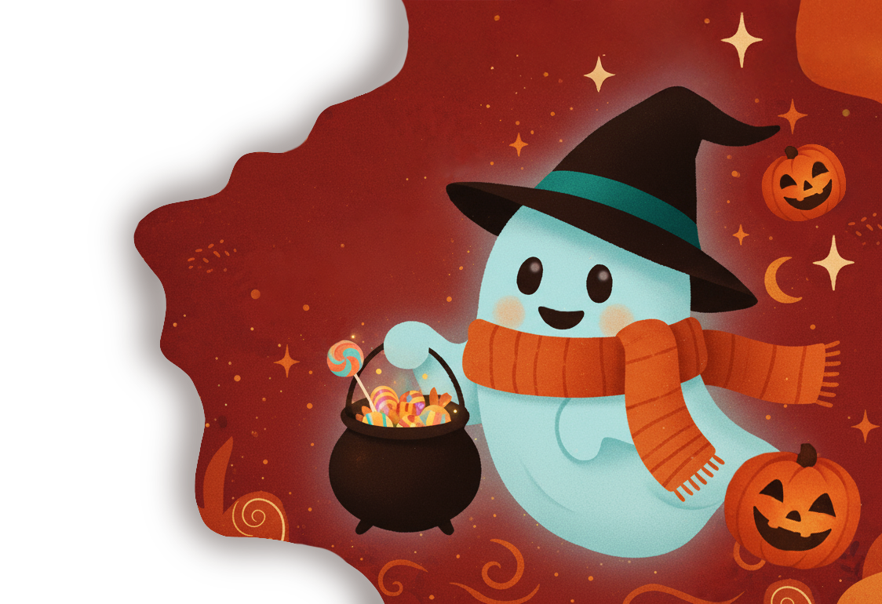

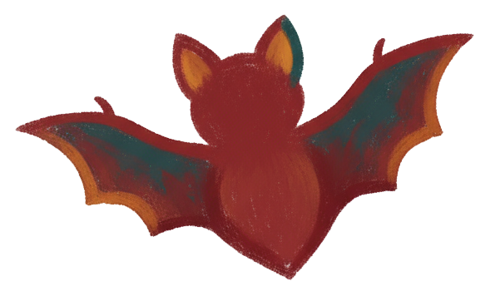

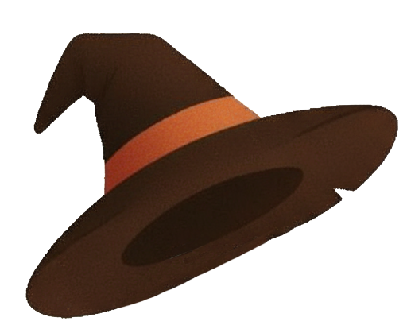

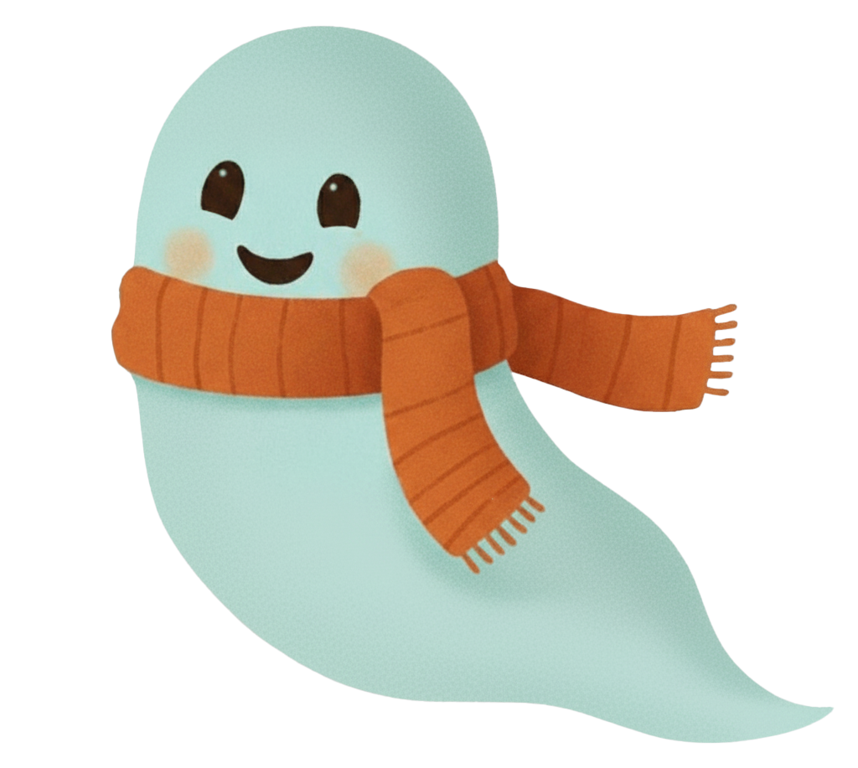

Meet Wispy, the Spirit keeper
HALLOWEEN
The Magic of October nights

Slide 2

Meet Wispy, the Spirit keeper
Not just a kind ghost, but
Wispy – the patron spirit of the holiday, a bit of a prankster, but with a kind heart.
He guards the lanterns, helps children not be afraid of the dark and whispers funny spells to make the night a joyful one.

Slide 3

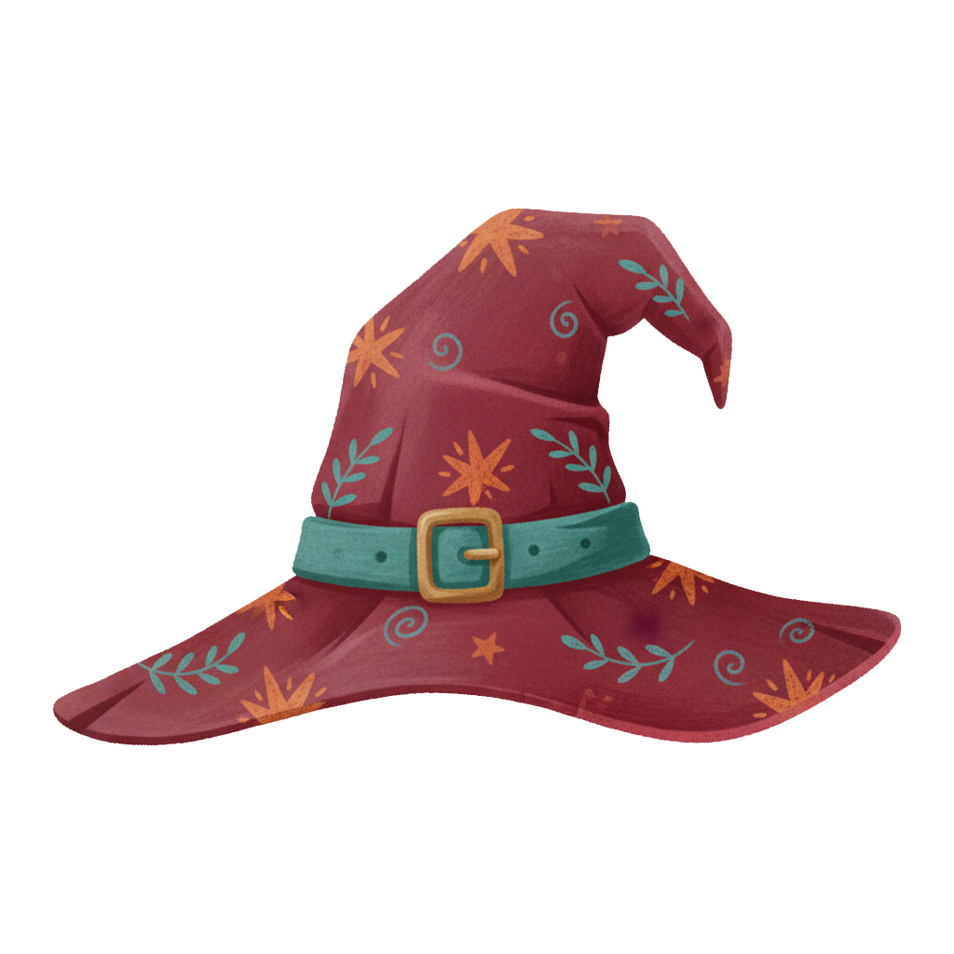

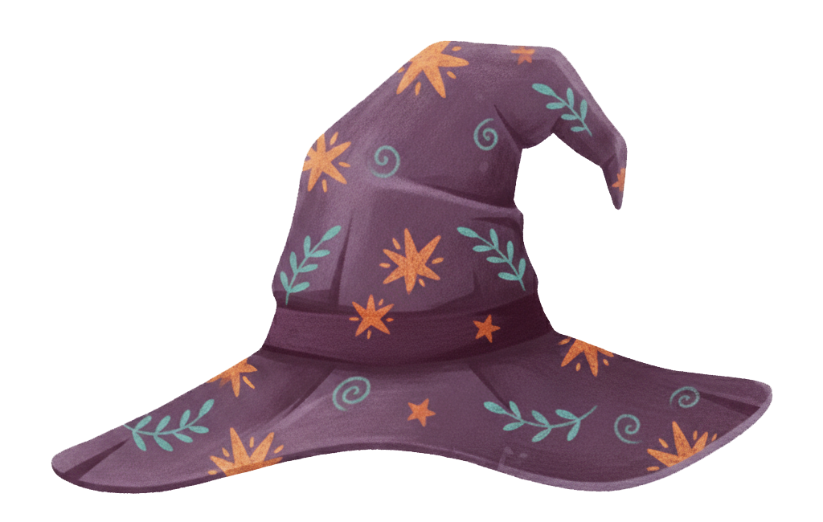
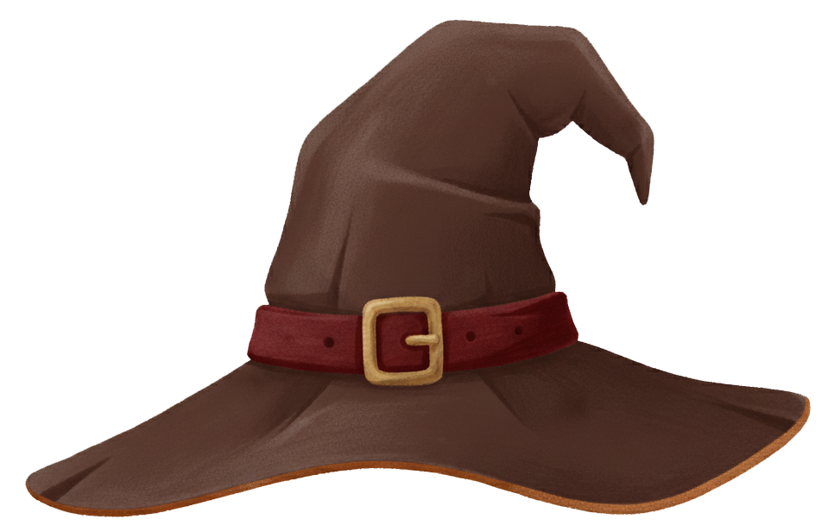
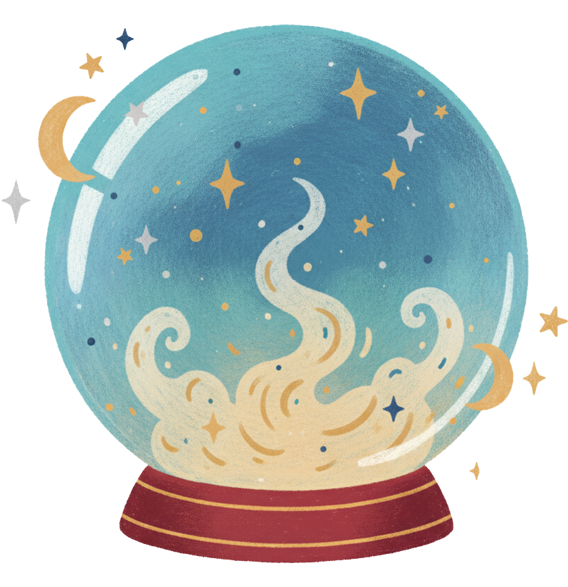
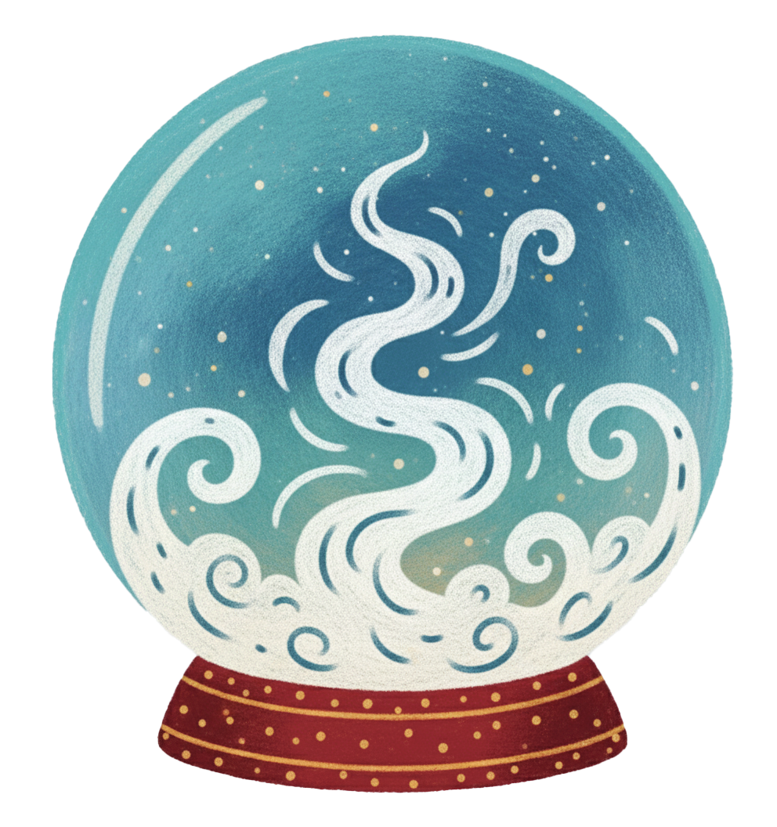
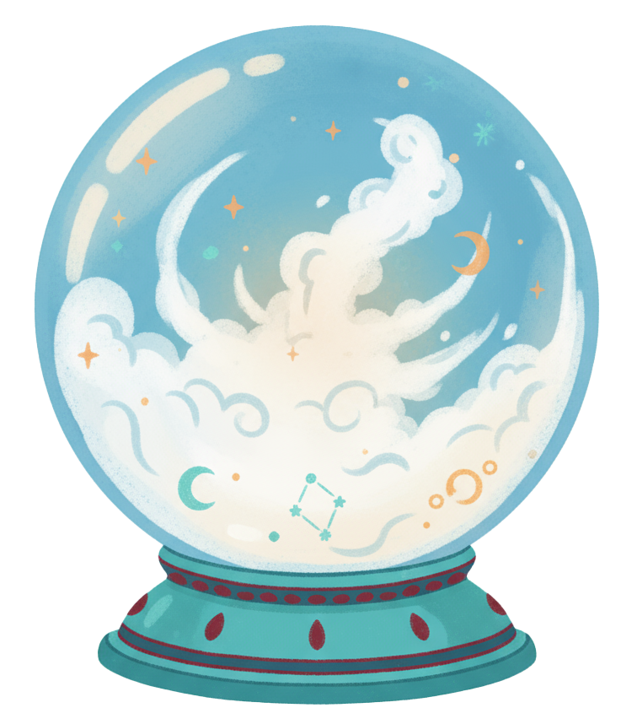
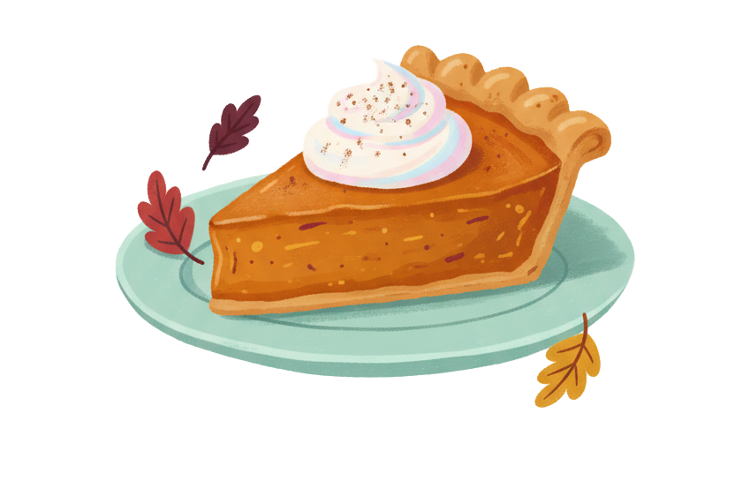

Morning Magic
1
2
3
The right attitude
Creepy entertainment
Careful preparations
Behold the main Halloween ingredients!

Slide 4


2
3
1
Creepy entertainment
Careful preparations
The right attitude
Morning Magic
The morning hums in gentle light,
With cookies warm and candles bright.
A hint of spice floats through the air,
While pumpkins glow with tender care.
The world feels calm, the day feels new
And evening magic waits for you.

Slide 5
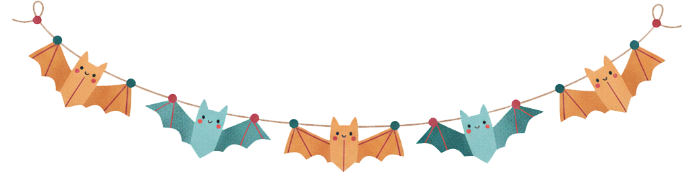
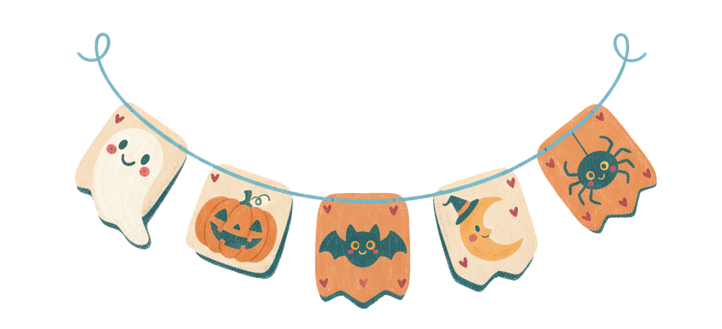
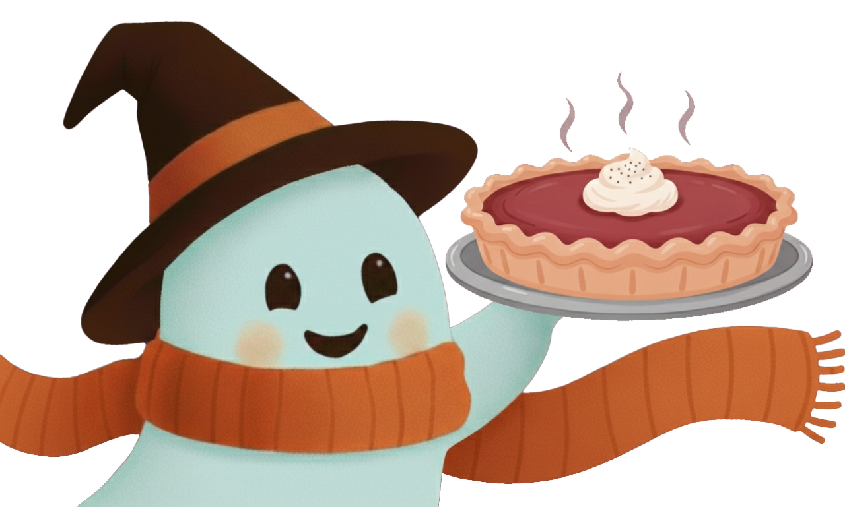


Jack, the Pumpkin Lantern
Decoration & Treats
How to carve a friendly pumpkin:
Decoration?
Check!
Treats?
Double check!
The laughter is ready, the music’s in the air
and every pumpkin is glowing with care
Cozy lights, sweet smells and cheerful colors -
The perfect mix for a heartwarming
Halloween afternoon

Slide 6
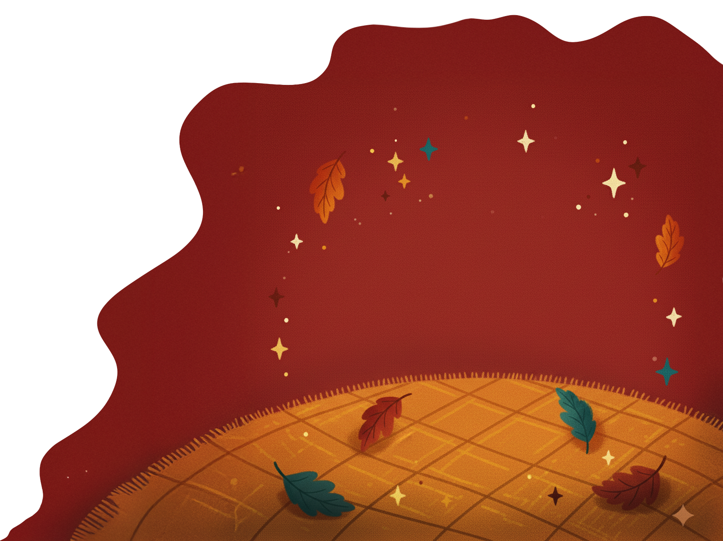
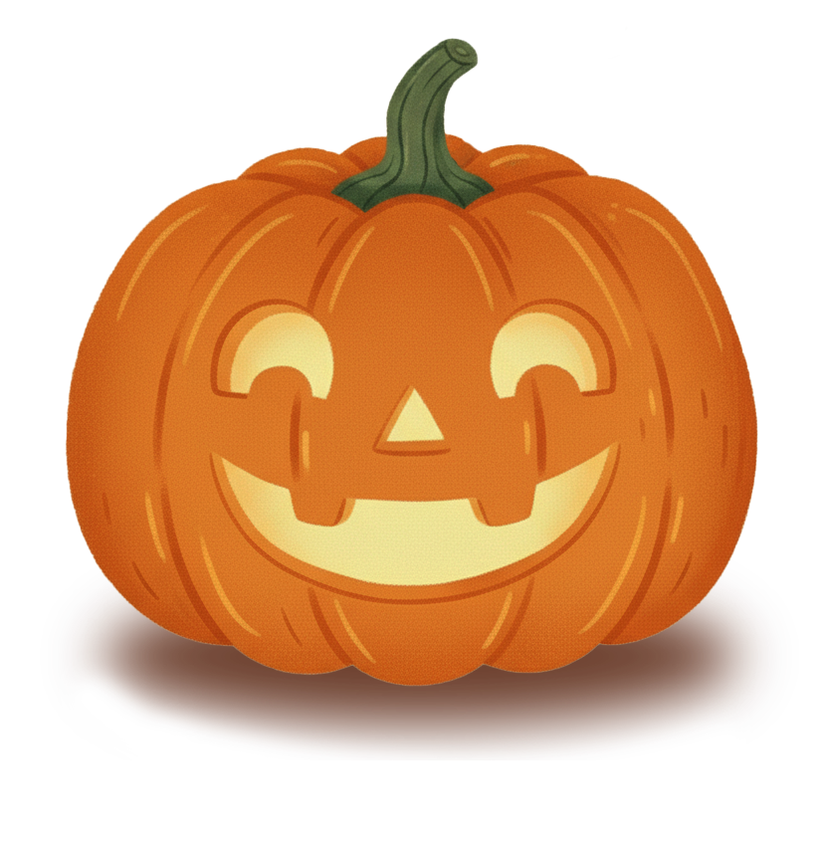
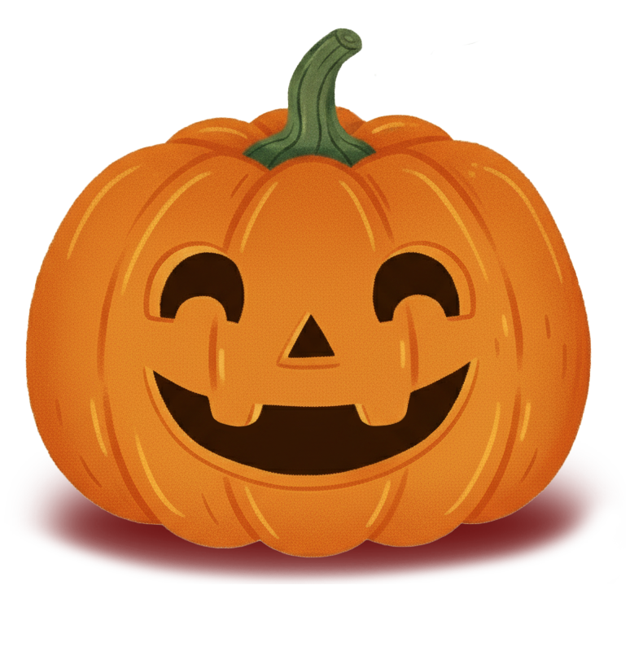






Movie Night with Friends
Jack, the Pumpkin Lantern
How to carve a friendly pumpkin:
Pick the roundest pumpkin you can find
Cut the lid and scoop out the seeds
Draw a cheerful smile and laughing eyes - no sharp-and-scary teeth allowed!
Place a candle inside and whisper: “shine kindly tonight”
Movie night, blankets, popcorn, and stories whispered by Wispy himself

Slide 7


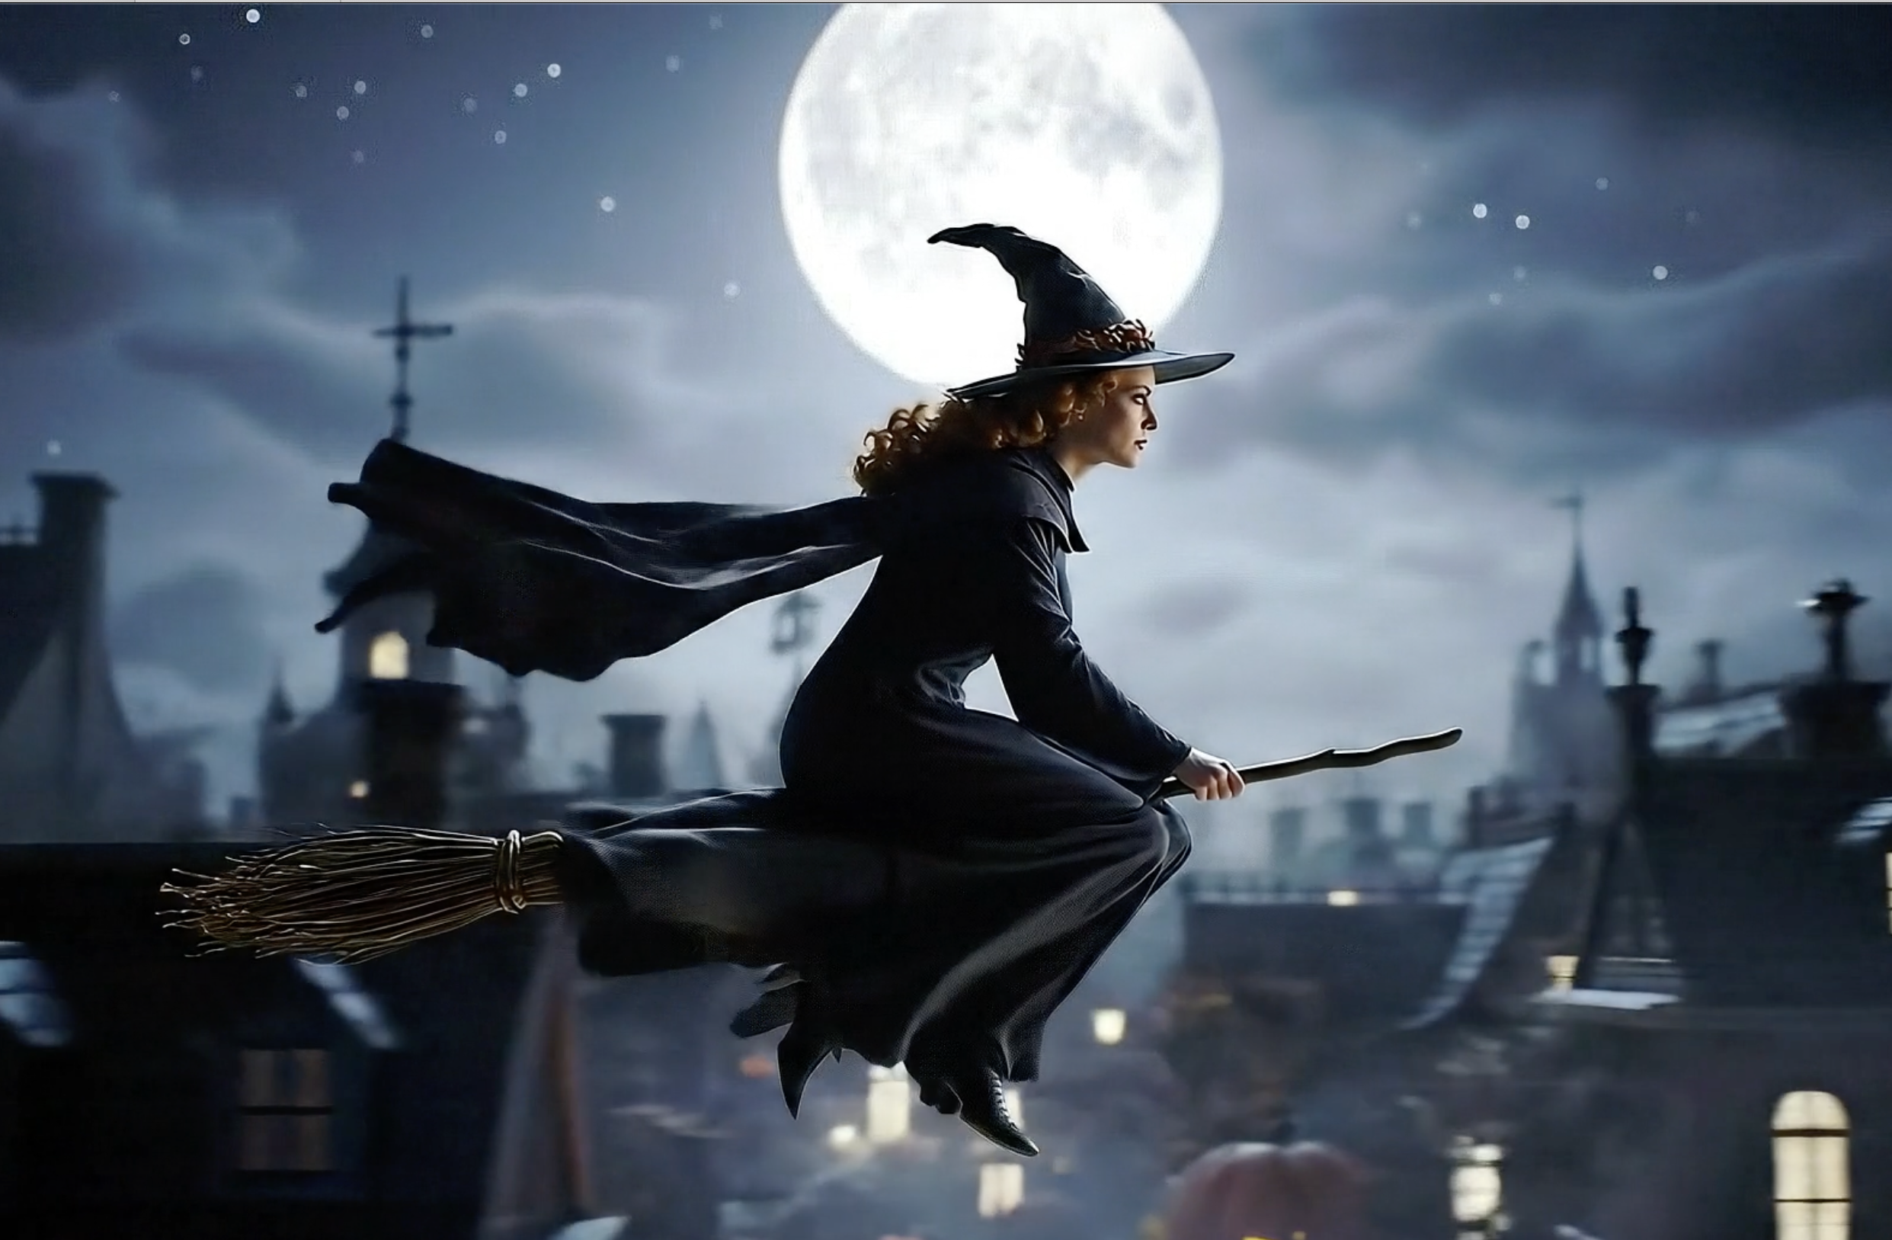
Movie Night with Friends
Movie night, blankets, popcorn, and stories whispered by Wispy himself

Slide 8

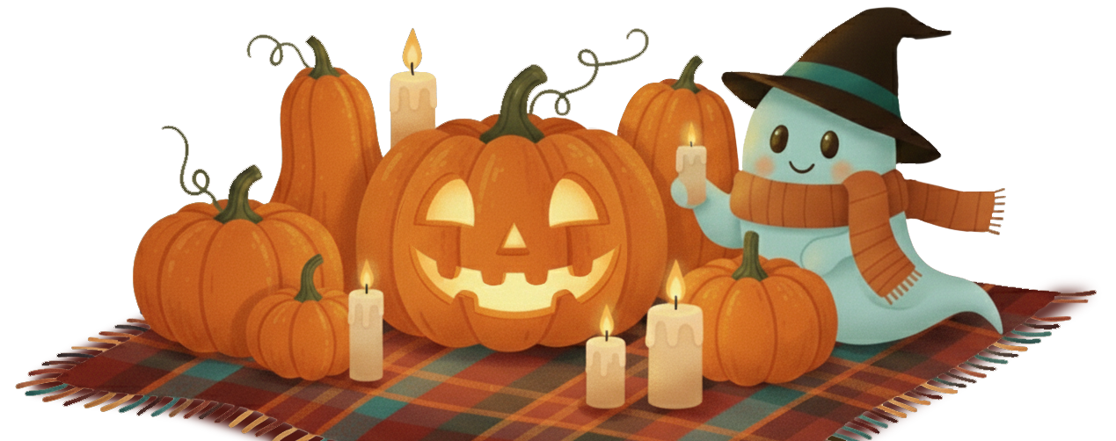
HAPPY HAUNTINGS!

